Slide 1
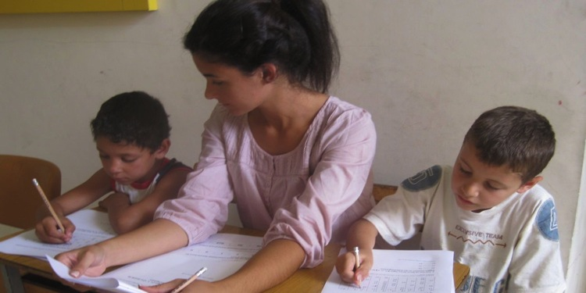
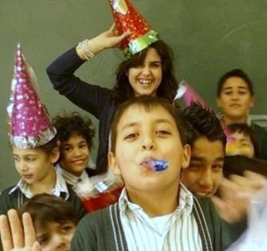
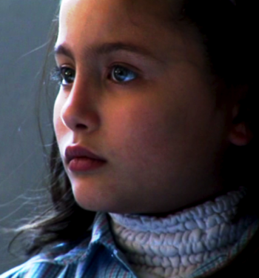
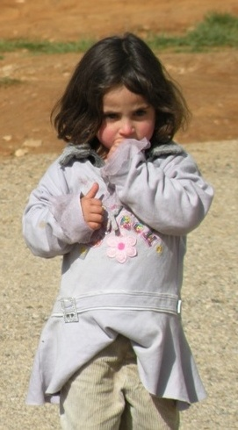

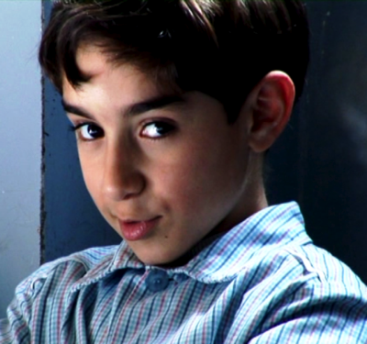

From Teach For Lebanon
to TFL-US
Winter 2012

Slide 2
Content Outline
Content Outline
Why Teach For Lebanon?
How does Teach For Lebanon work?
Growth plan for Teach For Lebanon
Support Teach For Lebanon
TFL-US

Slide 3
Education inequality remains a significant problem in Lebanon
Across Lebanon, only 49% of students successfully complete secondary education.
The problem is significantly worse in rural areas:
  Passing rates are at least 10% lower in West Bekaa than in Mount Lebanon, for example.
This can be defined as the Theory of Problem
Only 49% successfully complete secondary cycle

Slide 4
Theory of Problem
Theory of Problem
Repeated failure in class
Low qualifications of teachers
Low motivation
Low achievement
Low expectations of parents
Inability to retain ambitious teachers
Limited exposure to opportunities
Limited field of vision and ambition
Low motivation of teachers
Education not seen as a ticket for a better life

Slide 5
Theory of Change
Problem
Low qualifications of teachers
Inability to retain ambitious teachers
Limited exposure to opportunities
Education not seen as a ticket for a better life
Low motivation of teachers
Repeated failure in class
Limited field of vision and ambition
Low expectations of parents
Teach For Lebanon recruits:
highly qualified
ambitious
motivated Fellows
Teach For Lebanon Fellows widen students’ vision and exposure to opportunities
Fellows encourage parents to believe in their children’s potential
What Teach For Lebanon does
Fellows will help students achieve significant academic progress

Slide 6
Theory of Change
VISION
Teach For Lebanon aims to eliminate
educational inequality in Lebanon while fostering youth leadership and promoting civic engagement.
MISSION
Our mission is to provide underprivileged children with a quality education by supplying them with talented Fellows who help to empower them.
Notes:
Make bigger

Slide 7

Launch of Teach For Lebanon
Launch of Teach For Lebanon in August 2008
Drive to Reduce Education Inequality in Lebanon
After two years of collaborative efforts, Teach For Lebanon was officially launched on August 2008
Being involved with the initiative for more than two years, in July 2008, Ali Dimashkieh took the lead, as CEO of Teach For Lebanon, to kick off the work
Successful Experiences
(Teach For America,
Teach First)
International Support
(Teach For All)

Slide 8
Content Outline
Content Outline
Why Teach For Lebanon?
How does Teach For Lebanon work?
Growth plan for Teach For Lebanon
Support Teach For Lebanon
TFL-US

Slide 9
Teach For Lebanon Operating Model
Recruitment
Recruit highest-quality talent who demonstrate core competencies to drive impact on student achievement and become long-term leaders able to effect systemic change
Training
Provide participants (Fellows) with training and professional development needed to impact student achievement
School
Placement
Place participants (Fellows) for a minimum of 2 years in full-time teaching positions in regions suffering from education inequality
Ongoing
Support
Provide continuous support to the placed Fellows through school visits and additional training in order to maximize their performance
Fellow Alumni Support
Provide support to Alumni Fellows (e.g. capability building programs, career guidance, job placement) to create a sustainable effort towards education equality
Measuring Impact
Continuously measuring the impact of the program on student achievement and social behavior as well as school community

Slide 10
Teach For Lebanon Operating Model
Profile of Teach For Lebanon Fellows – First Cohort
TFL Recruitment Process
Profile of Selected Applicants
Stage 1
Internal Review
Stage 2
Interview
Stage 3
Assessment Day
202 Applicants
69 Applicants
Other
32 Applicants
LU
Male
UoB
GPA
Personal Information
Determination for change
Mock Lesson
Group Activity
Self-Evaluation
Personal Interview
9 Selected Applicants
5
Female
AUB
4
Average GPA of selected candidates:
3.25

Slide 11
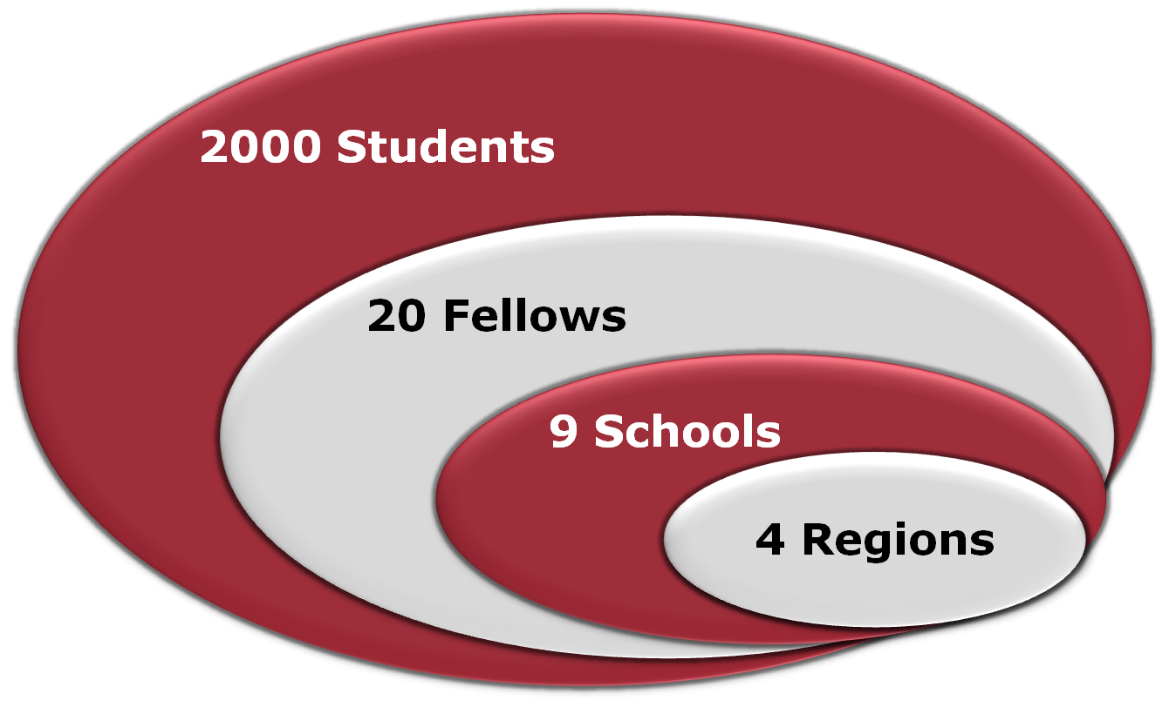
Current Scope of Teach For Lebanon
Current Scope of Teach For Lebanon
Current Scope of Teach For Lebanon

Slide 12
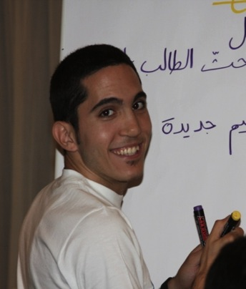
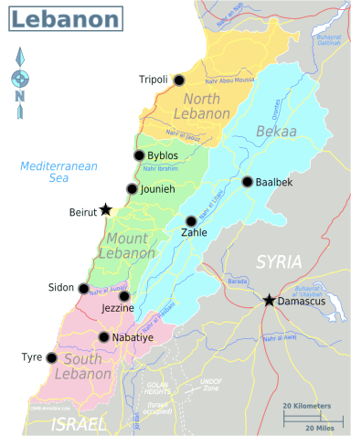
Meet a Fellow
Youssef Semaan
Bachelors in Biology– Pre-medical student
American University of Beirut, Lebanon
Cohort 1
Halba Maronite School
Why Teach For Lebanon?
“When I heard about Teach For Lebanon at 20 years old, I was one of the youngest Bachelor’s degree holders. I graduated from the American University of Beirut in June 2009, and decided to join Teach For Lebanon, a program that grasped my interest since that day of their first presentation in one of my senior seminar courses.
On a personal level, I believe this experience will change and add a lot to my personality and my general experience and competencies. Academia has always been a major field of passion for me which made me realize what a perfect baggage this was to be carrying on to a faraway land, where all my ambitions of change can indeed leave one imprint of its kind in the minds and hearts of some young souls who have had less opportunities than others”

Slide 13
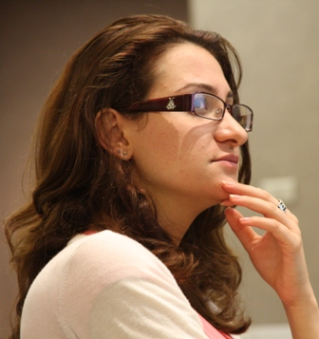
Meet a Fellow
Dana Hamzeh
Bachelors in Business Administration
University of Guelph-Humber, Toronto, Ontario
Cohort 1
Al Erfan School
Why Teach For Lebanon?
“After being away from Lebanon for 12 years I knew that I wanted to come back and give back to my country. TFL gave me the chance to do just that. I felt that I would be an asset to any school that I would be a part of as well as to the students that I will be teaching. In addition to that I strongly agree with TFL’s mission and beliefs in respect to education in Lebanon. Today I am very glad and fortunate to be part of TFL and to be working with a team that is hardworking, professional and passionate.”

Slide 14
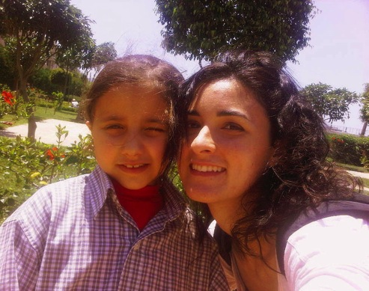
Meet a Fellow
Minerva Faddoul
Bachelor’s of Arts in Psychology;
Minor in Education
University of Balamand, Al-Koura, Lebanon
Cohort 2
Bakhoun Public School
Why Teach For Lebanon?
“Having spent most of my life, school education and community service in Nigeria, I was ready to come back and reconnect with my country, Lebanon. My years as an undergraduate placed the initial stepping stones to doing just that. Studies and observations brought to my attention an increased knowledge about the poor schooling system in parts of Lebanon and the psychological discord that developing children were undergoing, be it in the home or the school. This awareness has moved me and brought about the desire to make a difference and impact change in these children’s education and eventually lives. Upon learning about TFL’s mission, I felt at home and I was sure that despite its challenges this is what I wanted to do. To be able to work with children and serve them academically and developmentally today is all I can ask for. I have no regrets about this movement of which I have become a part. I am excited to see how the seeds that we, the TFL team, plant now are going to flourish and bring about change across Lebanon in the years to come.”

Slide 15
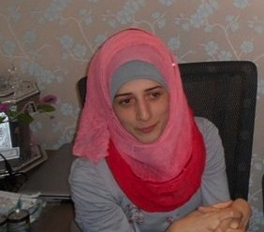
Meet a Fellow
Rana Saleh
Bachelor’s in Nutrition and Dietetics
American University of Beirut, Lebanon
Cohort 2
Maaroub Public School
Why Teach For Lebanon?
“I joined the program after I saw a presentation about TFL at my university. I never expected that such a program would exist in Lebanon also, at that time, I didn’t have teaching in mind. However, I knew that this experience is different than any other and will definitely be life changing. I wanted to have an impact on kids who were less fortunate in life.
My first year of teaching created inside of me a sense of responsibility towards my community as to contribute and try to eliminate the problem of educational inequality in my country. I now have stronger beliefs in the mission because I could see its positive realm of influence.”

Slide 16
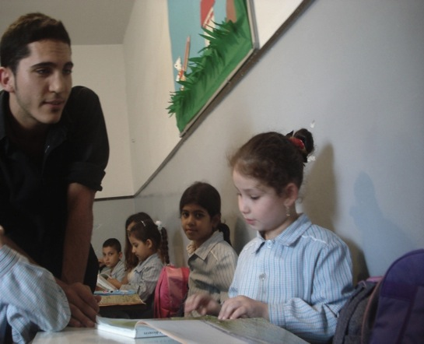
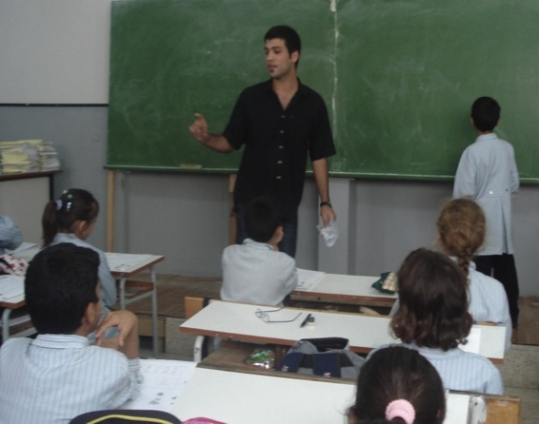
Impact of Teach For Lebanon
Feedback from principals, coordinators and teachers
Principals and coordinators across all schools recognize the Fellows are hardworking
Fellows are working long hours between their teaching hours and their involvement in extracurricular activities, it is very clear to see how motivated they are to do their best.
Principal in a partner school
Non -Teach For Lebanon teachers in the schools positively evaluate the new approach that Fellows use in teaching
Fellows are able to convey the message to students in an enjoyable way using games. The French or Arabic sessions are becoming to the students as enjoyable as a sports session.
Non -Teach For Lebanon teacher in a partner school
Notes:
16

Slide 17
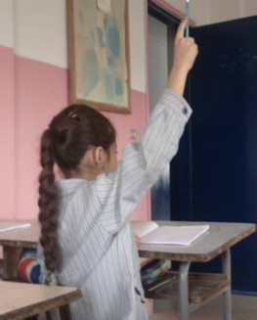
Impact of Teach For Lebanon
Feedback from parents and students
The overall impressions of parents towards the Fellows were mainly around the Fellows’ approach in teaching, their contribution to students in foreign languages (English and French), and the extracurricular activities.
For the first time, my child understands Science rather than simply memorizing
Mother of a student in a Fellow’s class
Parents of students in Fellows’ classes are happy with the improvement of their children in English
Principal of a partner school
Students and Fellows are developing a strong relationship of trust; the motivation of students seems to be increasing, in addition they appreciate the individual attention received by the Fellows
I like Mr Joe, because he explains the lesson 2 million times if I don’t understand it
Student in a Fellow’s class
I enjoy studying the language and am getting good grades because I like the teacher
Student in a Fellow’s class

Slide 18
Teach For Lebanon Board of Trustees
Teach For Lebanon Board of Trustees
Dr. Youssef El Khalil
Chairman
Central Bank of Lebanon
Senior Director of the Financial Operations Department
Dr. Hassib Jaber
Vice-Chairman
Deloitte
Partner
Dr. Nuhad Daghir
Member; Executive Committee
Act For Lebanon
Founding Member and Dean Emeritus at AUB
Mr. Nazih Zeidan
Member; Executive Committee
American University of Beirut
Former Assistant of the President for Development and Alumni Affairs
Dr. Joseph Jabbra
Member
Lebanese American University
President
Dr. Peter Dorman
Member
American University of Beirut
President
Ms. Salwa Baassiri
Member
Lebanese National Commission for UNESCO
Secretary General
Mr. Rabih Abouchakra
Member
Abu Dhabi Crown Prince Court
Managing Director, Office of Strategic Affairs
Mr. Ramsay Najjar
Member
Strategic Communication Consultancy
Founder

Slide 19
Content Outline
Content Outline
Why Teach For Lebanon?
How does Teach For Lebanon work?
Growth plan for Teach For Lebanon
Support Teach For Lebanon
TFL-US

Slide 20
Why TFL-US?
Launch of Teach For Lebanon in August 2008
Teach For Lebanon seed funding came from American-Lebanese businessmen and was channeled through Act for Lebanon
With the financial crisis reaching its zenith in 2010 many government and private organizations, as well as individuals, were not in a position to deliver on financial commitments made
This created a financial crisis for TFL and forced a change in strategy, emphasizing US donors
Charbel Tagher & Ray Debbane took the lead to create and incorporate TFL-US in late 2010.
501(c)3 status received in March 2011.

Slide 21
TFL-US Board
Teach For Lebanon Board of Trustees
Charbel Tagher
President & Treasurer
Specified Technologies Inc
President
Raymond Debbane
Vice President & Secretary
The Invus Group
President & CEO
Ghassan Saab
Member
Sorensen Gross Construction
CEO
Abdallah Geahel
Member
CitiWest Inc
President
Fundraising To Date:
2010-11 AY: $96,500
2011-12 AY: $259,300
2012-13 AY Target: $500,000

Slide 22
Content Outline
Content Outline
Why Teach For Lebanon?
How does Teach For Lebanon work?
Growth of Teach For Lebanon
Support Teach For Lebanon
TFL-US

Slide 23
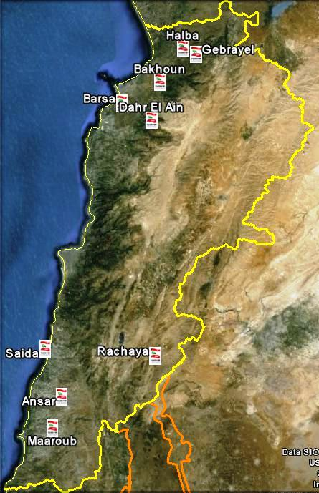
Growth
Year Two Growth Plan
Expansion in Number of Fellows
Fellows | Number
Cohort 1 | 12
Cohort of 2 | 8
Total Fellows for Year Two | 20
Partner Schools 2010-2011
Barsa Maronite School
Halba Maronite School
Ansar Typical School
Saida Generations School
Maaroub Public School
Bakhoun Public School
Dahr El Ain Maronite School
International School of Akkar (Gebrayel)
Irfan School Rachaya – Dahr El Ahmar

Slide 24
2011/12 Projected Sources of Funds

Slide 25
2011/12 Actual Sources of Funds
Most sources of funds did not deliver due to the crisis and internal TFL problems, leading to the emergency creation of TFL-US in order to keep TFL going
20%

Slide 26
Plan/Needs for Now Through AY 2012-13
AY 2012-13 Plan is to recruit 20-25 Fellows and work with 8 to 10 schools
TFL also needs to rebuild its people infrastructure
Financial need will be around $500K including a small cushion
TFL-US will need to raise at least 60% of that
Lebanese gov’t will likely provide 10-20%
Other sources will likely provide the rest (Banks, Grants, Diaspora)

Slide 27
Growth Plan
Year Two Growth Plan
Expansion in Number of Fellows
Fellows | Number
Cohort 3 | 20-25
Expansion Plans
Fellows | Number
Cohort 5 | 100
Expansion Plans
Fellows | Number
Cohort 7 | 150

Slide 28
Content Outline
Content Outline
Why Teach For Lebanon?
How does Teach For Lebanon work?
Growth of Teach For Lebanon
Support Teach For Lebanon
TFL-US

Slide 29
Teach For Lebanon Donors
Teach For Lebanon Donors Since Inception
Teach For Lebanon is grateful to the following donors for their support since its early days

Slide 30
Comprehensive List of Benefits for Donors
Advertise on recruitment panels, recruitment events
Recognition on quarterly Newsletter for funders
Visits to school (personalized as well as in-group)
Classroom observation
Give classroom lectures
Recognition on website homepage
Proactive mention when engaging with the press
Recognition on marketing material
Invitation to summer institute ceremony
Recognition on the website under the donors page

Slide 31



Slide 32
Teach For Lebanon and the American Diaspora
Launch of Teach For Lebanon in August 2008
Teach For Lebanon seed funds came from American-Lebanese businessmen through an organized effort by Act for Lebanon
Continuous monitoring and guidance by some supporters
Charbel’s first visit to Lebanon after 18 years
Continuous follow up on execution and progress
Reconnection with some of the original donors
Advocating for Teach For Lebanon in New York
A successful fundraising event in 2010
Follow up and updates to donors
Motivating others to institutionalize the fundraising efforts
TFL-US was born
Incorporation in the State of New york in 2011

Slide 33
Diaspora Involvement
Launch of Teach For Lebanon in August 2008
More than 12 Million Lebanese in the Diaspora
Lebanese Diaspora has always supported Lebanon when needed:
  Continuous personal and regional support during the civil war (1975 – 1991)
  Humanitarian support in 1997
  Lobbying and political support (2000 – 2005)
  Organizational and civic support in 2005
  Structured humanitarian and logistical support in 2006
  More Lebanese-International organizations since 2006

Slide 34

Launch of TFL-US
Launch of Teach For Lebanon in August 2008
Initial belief in the need to support education in Lebanon
Increasing interest in Teach For Lebanon operation
Credibility of the operation of TFL
Successful fundraising efforts
Charbel’s dedication to TFL
Transparency and clarity in operation
Teach For America is a successful long-running example
Monitoring and follow up with Teach For Lebanon

